Slide 1

Grow Mate
Projeto em Informática – Sensing My Home
Licenciatura em Engenharia Informática
Grupo 5
Notes:
Daniel

Slide 2

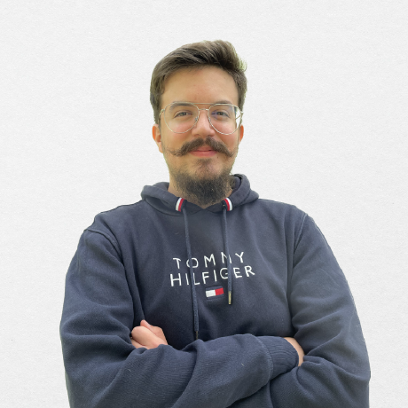
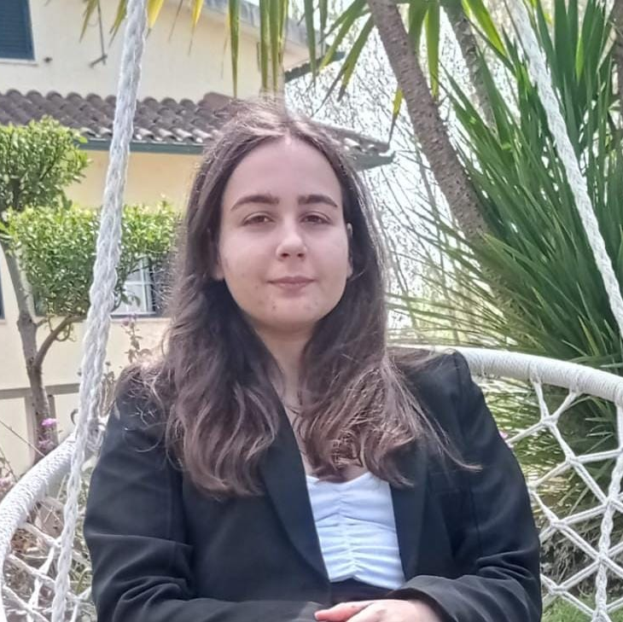

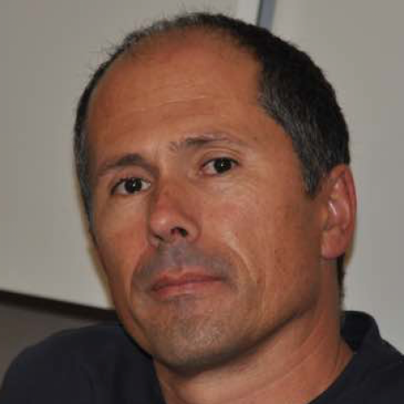
The Team
Artur Correia
André Butuc
Bruna Simões
Daniel Carvalho
José Luís Oliveira
(Advisor)
1

Slide 3
Context
40%
Development of a mobile app to manage house plants.
Facilitate the acclimatization process of plant species.
Provide daily reminders and suggestions to assure that the plants are receiving its proper needed care.
Suggest plant species that follow similar growth patterns and behavior.
2

Slide 4
Requirements Elicitation

Slide 5
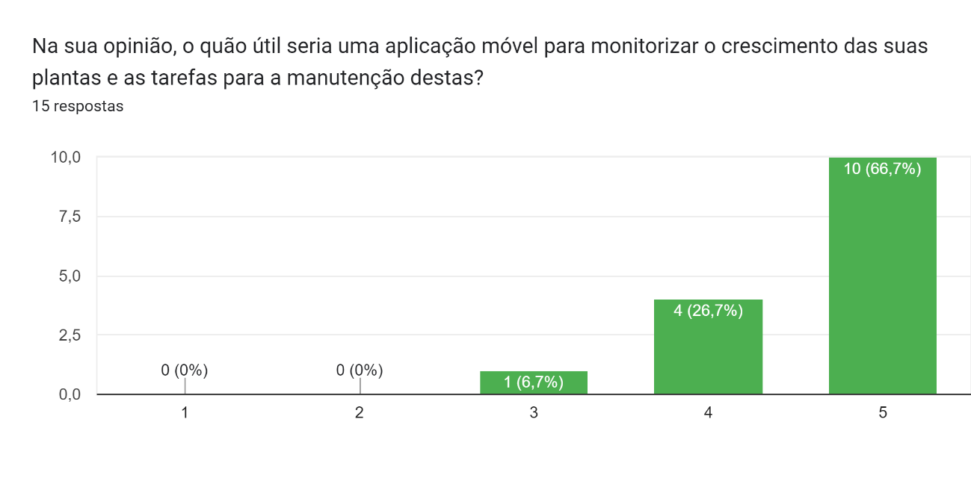
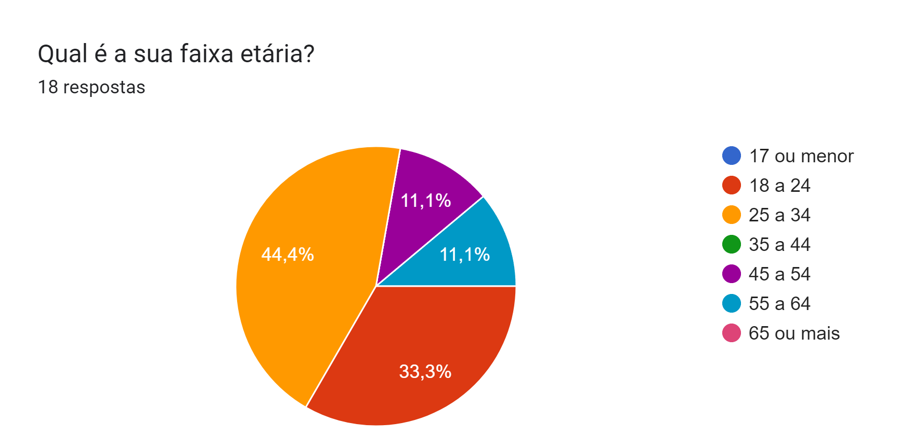
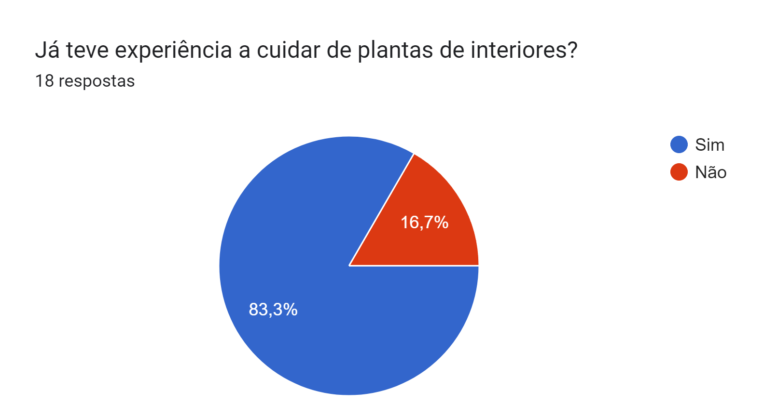
Questionnaire & Interviews
Demographic Information
4

Slide 6
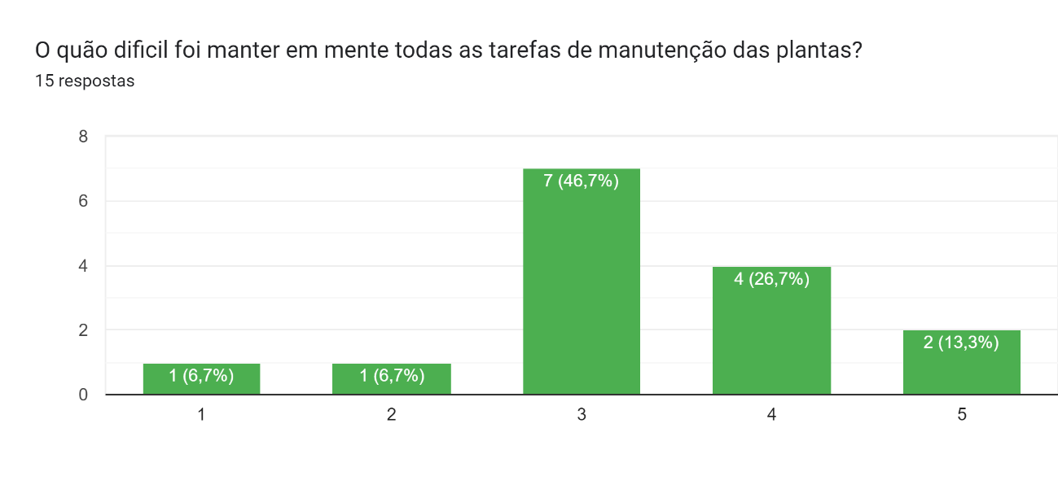
Questionnaire & Interviews
Interest in the Application
4

Slide 7
Questionnaire & Interviews
Main Challenges and Useful Functionalities
Challenges | Avg Difficulty*
Appropriate Luminosity | 3.4
Humidity | 3.3
Watering Frequency | 3.3
Soil Change Frequency | 3.3
Pot Change | 3.1
Plant Acclimatization | 3.5
* Scale of 0-5, with 0 being “Not a Problem” and 5 being “Very Problematic”
4

Slide 8
Questionnaire & Interviews
Main Challenges and Useful Functionalities
Functionalities | Utility Index*
Suggestion of Optimal Growth Conditions for Plants | 4.6
Plant Inventory and Condition Monitorization | 4.5
Task Management and Scheduling | 4.4
Sensors Integration | 4.4
Task Notifications | 3.9
Suggestions of New Plants to Grow | 3.5
Tips From Other Users | 3.2
Core
* Scale of 0-5, with 0 being “Not Useful” and 5 being “Very Useful”
5

Slide 9
Questionnaire & Interviews
Main Conclusions
Integration of a feature to help with pest detection and management
Plant journalling has appeal to users
Sensor integration might scare away casual users
Functionalities related to sensor integration separated in a premium category
6

Slide 10
Functional Requirements
Business Rules
Full catalogue of plants available in the database
All Users
Information about the species, ideal conditions for growth
Comments made by users with tips about their experience with the plants
Reputation system to influence which users' tips appear, based on their experience
House Plants Inventory and Management
Identify and monitor each individual plant
Journalling system
Suggestion of optimal conditions for each plant
All
Registered Users
Optimal temperature, humidity, luminosity and water frequency
Ideal soil mix, pot size and recommendations of additional nutrients and fertilizers
Expected color, size and condition
Tips on detection of pests and disease symptoms
Scheduling of tasks for plant maintenance, with notifications and reminders
7

Slide 11
Functional Requirements
Business Rules
Suggestion of new plants to grow
Takes into account the similarity with plants in the inventory of the user, as well as difficulty
Takes into account the climate
All
Registered Users
Acclimatization guide for newly bought plants, when necessary
Potential integration with weather API
Integration with measurements provided by sensors
Premium Users
Only
Sensors that measure the individual characteristics of a plant – soil moisture
Sensors that measures shared characteristics of all plants in a division – air temperature and humidity
Plant condition presented in a traffic light system
Comparison between measured conditions and optimal conditions
8

Slide 12
Other Functional Requirements
Administrative Functions
Web dashboard for database administrator
Admin can do CRUD operations over the DB
Admin can see relevant statistics related to the users
Authentication and Authorization Levels
Separation of functionalities according to the type of account
Historical Data
History of a user’s actions and history of sensors measurement for each plant
9

Slide 13

Actors
User with premium account
System Administrator
User without account
User with account
10

Slide 14
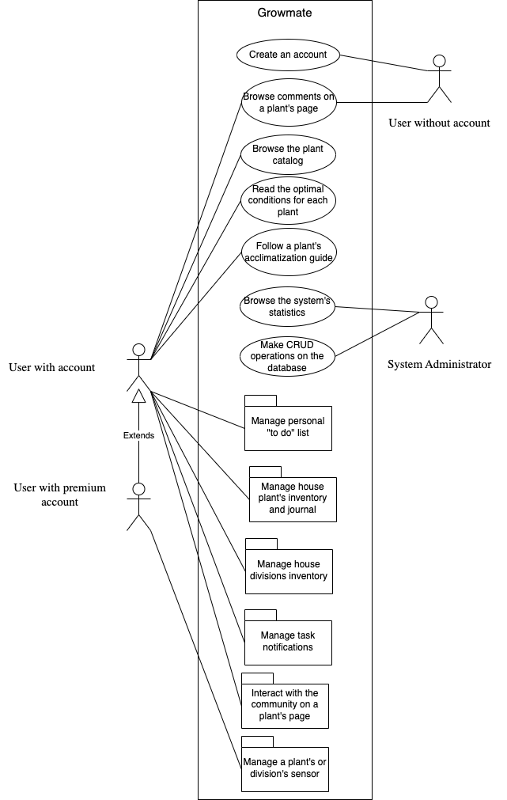
Use Cases
11

Slide 15
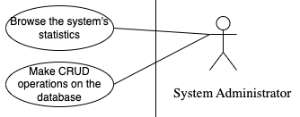
Use Cases - Administrator
12

Slide 16
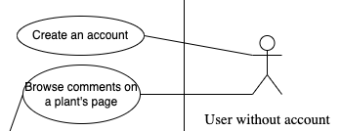
Use Cases – User without account
13

Slide 17
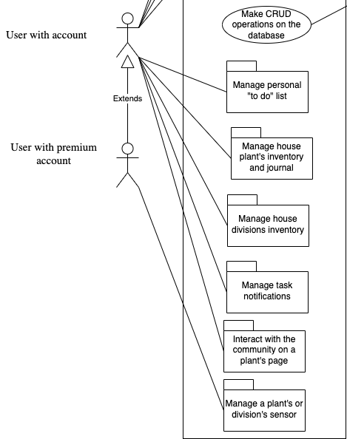
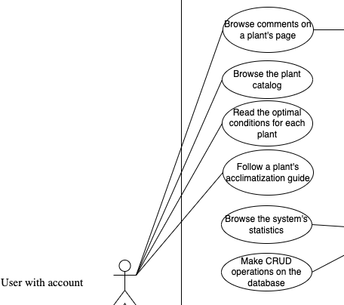
Use Cases – User with (premium) account
14

Slide 18
Non-functional Requirements
40%
Usability
Reliability
Scalability
Security
Interoperability
Efficiency
15

Slide 19



Assumptions & Dependencies
Internet connection
Sensors
16

Slide 20
Domain Model

Slide 21
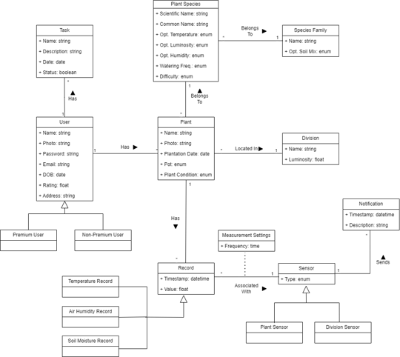
Domain Model diagram
18

Slide 22
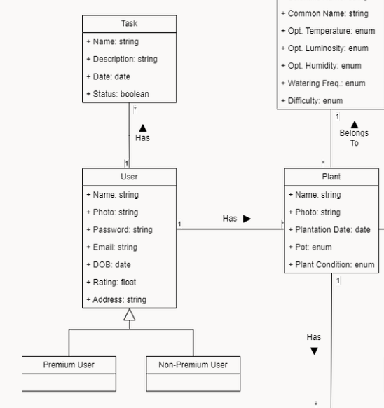
Users
Two types of users – Premium and Non-Premium.
Both receive tasks according to their plant's necessity.
Both can add several plants to their inventory.
Premium Users can associate sensors to certain divisions and/or plants.
19

Slide 23
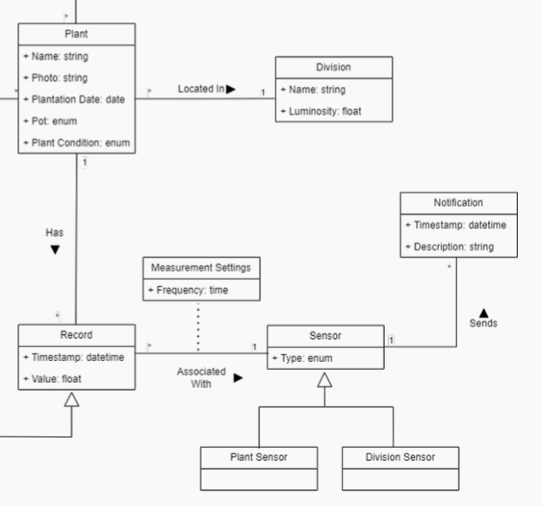
Values and Sensors
Record value registered are associated with each plant.
Values are measured by sensors, which may be plant-specific or division-specific sensors.
Several plants may be in one division.
Sensors associated with a division are feasible to all plants associated with that division.
20

Slide 24
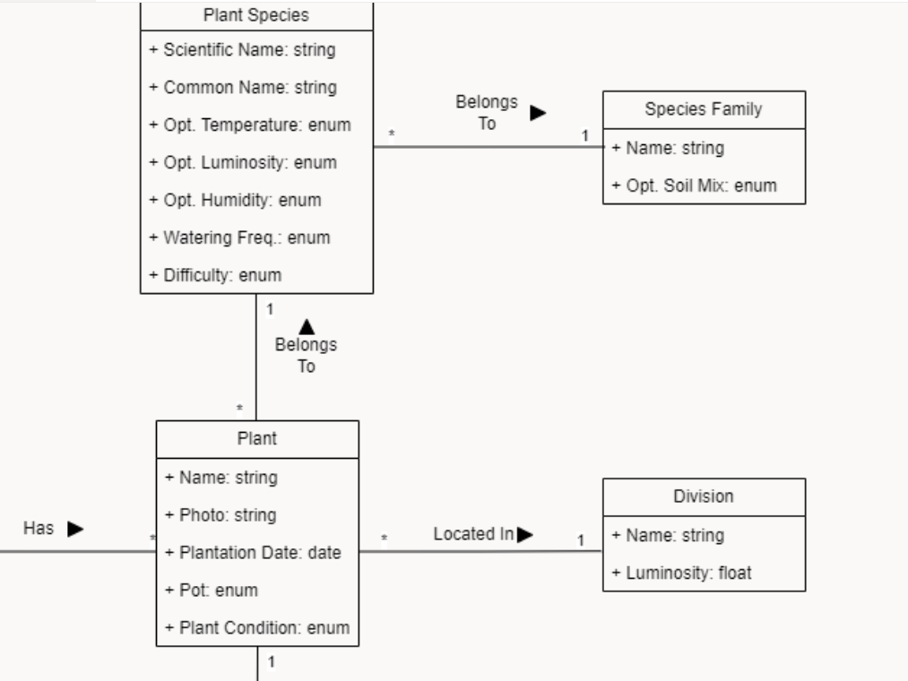
Plant information
A plant belongs to a plant species which in turn belongs to a Species Family.
A plant's Species Family can give information about the optimal soil mix.
Each species of plants has their own optimal temperature, luminosity and humidity.
21

Slide 25
System Architecture

Slide 26
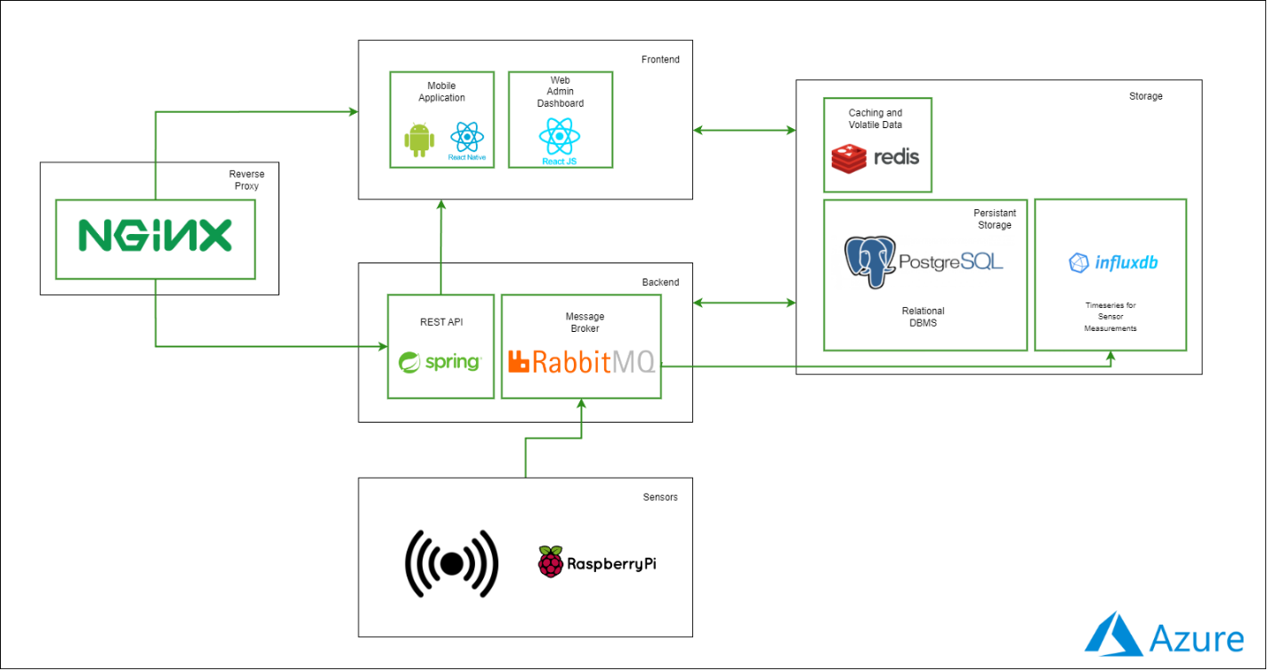
System Architecture & Deployment
23

Slide 27
Milestone Schedule
Milestone 1
Presentation of the lifecycle objectives and calendar for the project
Milestone 2
Presentation of the lifecycle architecture
Milestone 3
Protoype; Mid-Term Presentation
Milestone 4
Project Presentation
Milestone 3.1
Milestone 4.1
28/02
14/03
11/04
30/05
24/03
01/05
MARCH
APRIL
MAY
Integration of additional features
Deployment infrastructure stabilization
Defining core user stories
Non-Functional UI prototypes
Database
Modellling
API and backend stabilization
Final development of the UI
Developing the remaining user stores
Finalizing functional and non-functional requirement analysis
Determining which sensors to integrate in the system
Defining the problem domain
UI Development based on the main core user stories
Sensor data generation and integration basic pipeline
Core user stories implemented for the demonstration of the full-stack architecture
24

Slide 28
Schedule Update
Milestone 1
Presentation of the lifecycle objectives and calendar for the project
Milestone 2
Presentation of the lifecycle architecture
Milestone 3
Protoype; Mid-Term Presentation
28/02
14/03
Milestone 3.1
11/04
24/03
MARCH
APRIL
Defining core user stories
Non-Functional UI prototypes
Database
Modellling
API and backend stabilization
Final development of the UI
Developing the remaining user stores
Finalizing functional and non-functional requirement analysis
Determining which sensors to integrate in the system
Defining the problem domain
UI Development based on the main core user stories
Sensor data generation and integration basic pipeline
Core user stories implemented for the demonstration of the full-stack architecture
25

Slide 29
Mocks

Slide 30
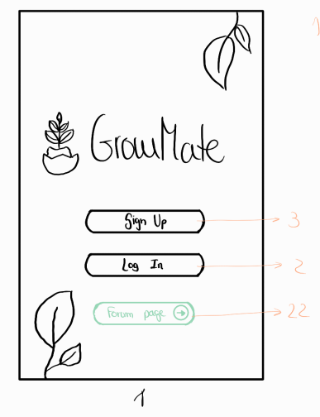
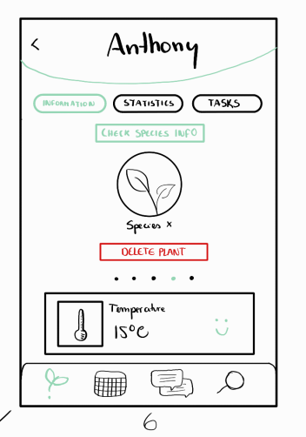
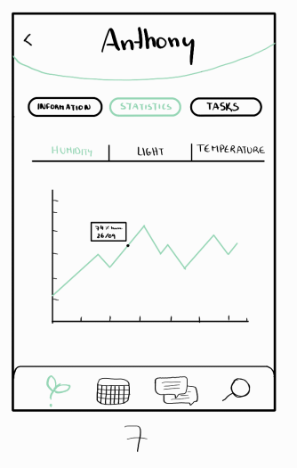

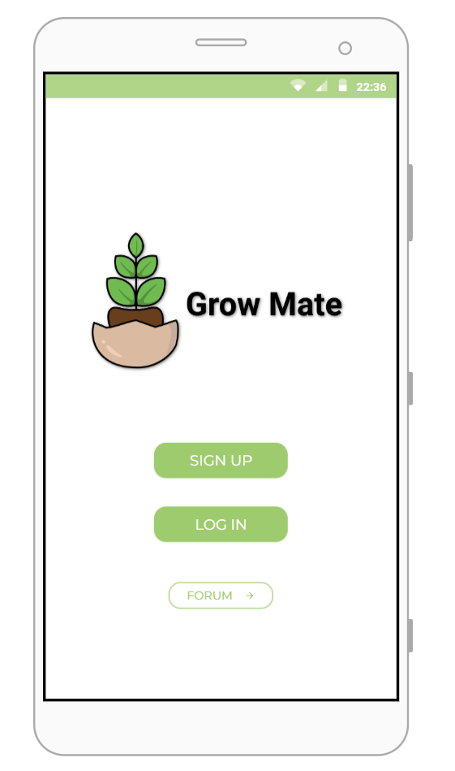
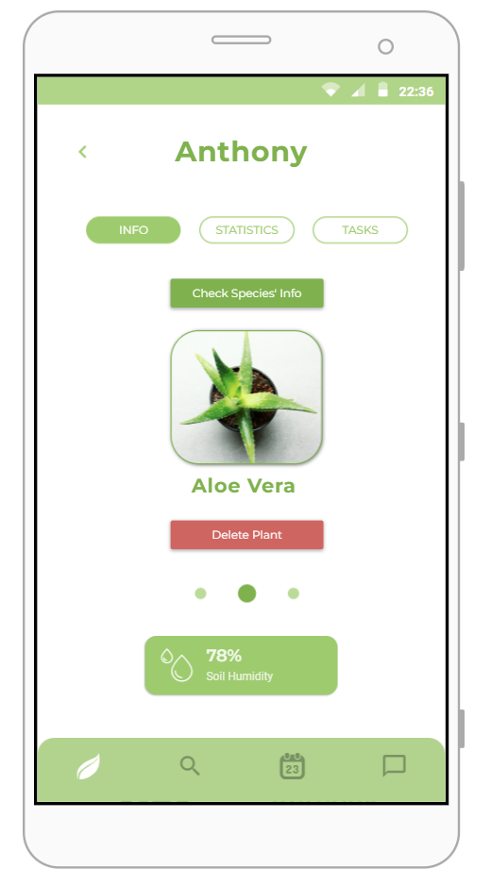
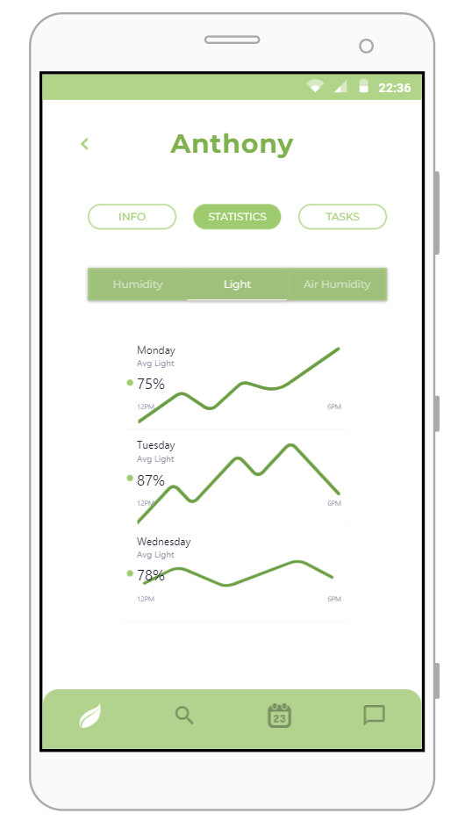
Prototipo_.pdf
Grow Mate.pdf
27

Slide 31
Grow Mate

